Slide 1
Guide to Computer Forensics and Investigations
Fourth Edition
Chapter 6
Working with Windows and DOS Systems

Slide 2
Objectives
Explain the purpose and structure of file systems
Describe Microsoft file structures
Explain the structure of New Technology File System (NTFS) disks
List some options for decrypting drives encrypted with whole disk encryption

Slide 3
Objectives (continued)
Explain how the Windows Registry works
Describe Microsoft startup tasks
Describe MS-DOS startup tasks
Explain the purpose of a virtual machine

Slide 4
Understanding File Systems

Slide 5
Understanding File Systems
File system
  Gives OS a road map to data on a disk
Type of file system an OS uses determines how data is stored on the disk
A file system is usually directly related to an OS
When you need to access a suspect’s computer to acquire or inspect data
  You should be familiar with the computer’s platform

Slide 6
Understanding the Boot Sequence
Complementary Metal Oxide Semiconductor (CMOS)
  Computer stores system configuration and date and time information in the CMOS
    When power to the system is off
Basic Input/Output System (BIOS)
  Contains programs that perform input and output at the hardware level

Slide 7
Understanding the Boot Sequence (continued)
Bootstrap process
  Contained in ROM, tells the computer how to proceed
  Displays the key or keys you press to open the CMOS setup screen
    Could be Delete, F2, F10, Ctrl+Alt+Insert, Ctrl+A, Ctrl+S, Ctrl+F1, or something else
CMOS should be modified to boot from a forensic floppy disk or CD
    When a subject’s computer starts, you must make sure it boots to a forensic floppy disk or CD, because booting to the hard disk overwrites and changes evidentiary data.

Slide 8
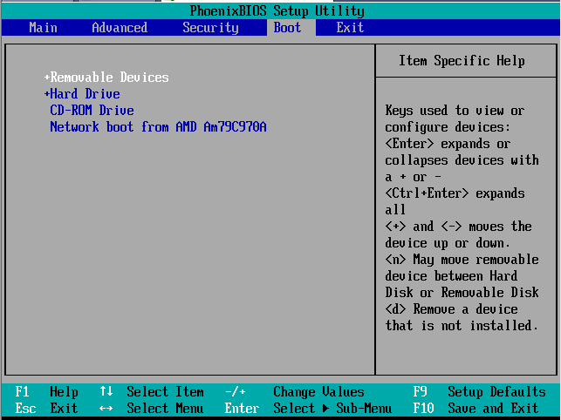
BIOS Setup Utility

Slide 9
Understanding Disk Drives
Disk drives are made up of one or more platters coated with magnetic material
Disk drive components
  Geometry—Geometry refers to a disk’s structure of platters, tracks, and sectors.
  Head—The head is the device that reads and writes data to a drive. There’s one head
  per platter.
  Tracks—Tracks are concentric circles on a disk platter where data is located.
  Cylinders—A cylinder is a column of tracks on two or more disk platters. Typically,
  each platter has two surfaces: top and bottom.
  Sectors—A sector is a section on a track, usually made up of 512 bytes Holds 512 bytes,

Slide 10
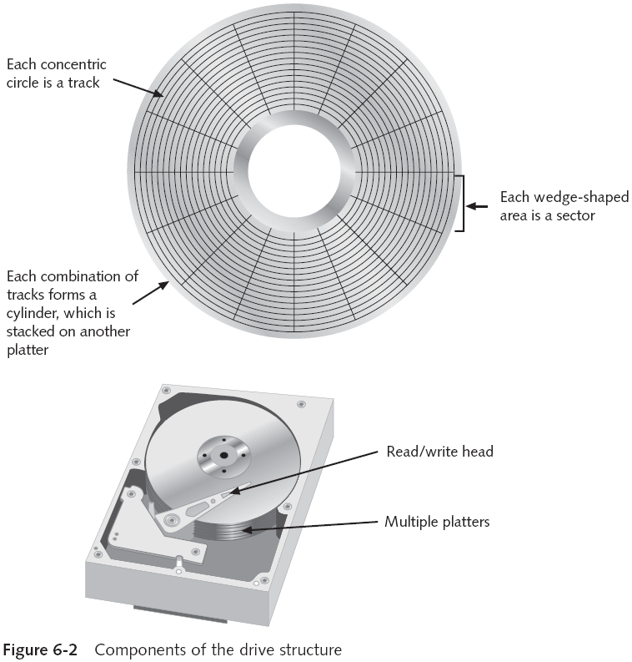

Slide 11
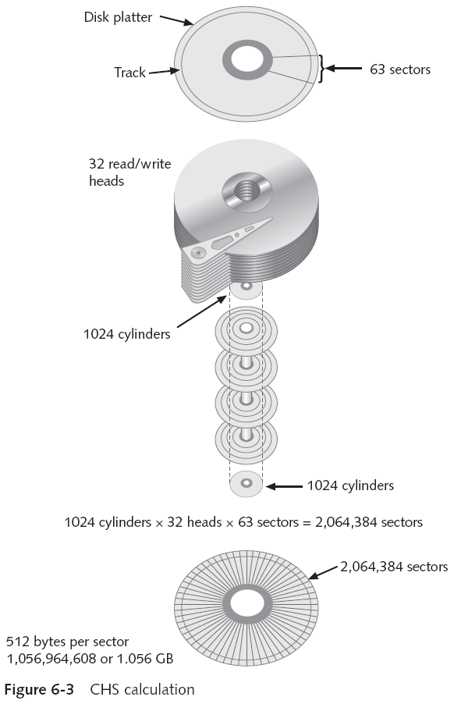

Slide 12
Understanding Disk Drives (continued)
Properties handled at the drive’s hardware or firmware level
  Zoned bit recording (ZBR)
  Track density
  Areal density
  Head and cylinder skew

Slide 13
ZBR is how most manufacturers deal with a platter’s inner tracks being shorter than its outer tracks. Grouping tracks by zones ensures that all tracks hold the same amount of data
Track density is the space between each track.
Areal density refers to the number of bits in one square inch of a disk platter. This number includes the unused space between tracks.
Head and cylinder skew are used to improve disk performance.

Slide 14
Exploring Microsoft File Structures

Slide 15
Exploring Microsoft File Structures
File Allocation Table (FAT), and New Technology File System (NTFS).
In Microsoft file structures, sectors are grouped to form clusters
  Storage allocation units of one or more sectors
Clusters are typically 512, 1024, 2048, 4096, or more bytes each
Combining sectors minimizes the overhead of writing or reading files to a disk

Slide 16
FAT (File Allocation Table) - This is a file system that was first introduced in the late 1970s and was used by many Microsoft operating systems, including MS-DOS and Windows 95
NTFS (New Technology File System) - This is the default file system used by most modern versions of Windows, including Windows 10. It provides improved performance and security over FAT and supports larger file sizes, more advanced features like encryption and compression, and better error correction.
exFAT (Extended File Allocation Table) - This is a file system that was introduced in 2006 and is optimized for use on flash drives and other removable storage devices
ReFS (Resilient File System) - This is a file system that was introduced in Windows Server 2012 and is designed for use with large-scale data storage. It supports features like automatic data integrity checks, better error correction, and support for larger file sizes and storage volumes.
CDFS (Compact Disc File System) - This is a file system that is used for optical discs like CDs and DVDs.

Slide 17
Exploring Microsoft File Structures (continued)
Clusters are numbered sequentially starting at 2
  First sector of all disks contains a system area, the boot record, and a file structure database
OS assigns these cluster numbers, called logical addresses
Sector numbers are called physical addresses
    because they reside at the hardware or firmware level and go from address 0 (the first sector on the disk) to the last sector on the disk.

Slide 18
Disk Partitions
A partition is a logical drive
FAT16 does not recognize disks larger than 2 GB
  Large disks have to be partitioned
Hidden partitions or voids
  Large unused gaps between partitions on a disk
Partition gap
  Unused space between partitions

Slide 19
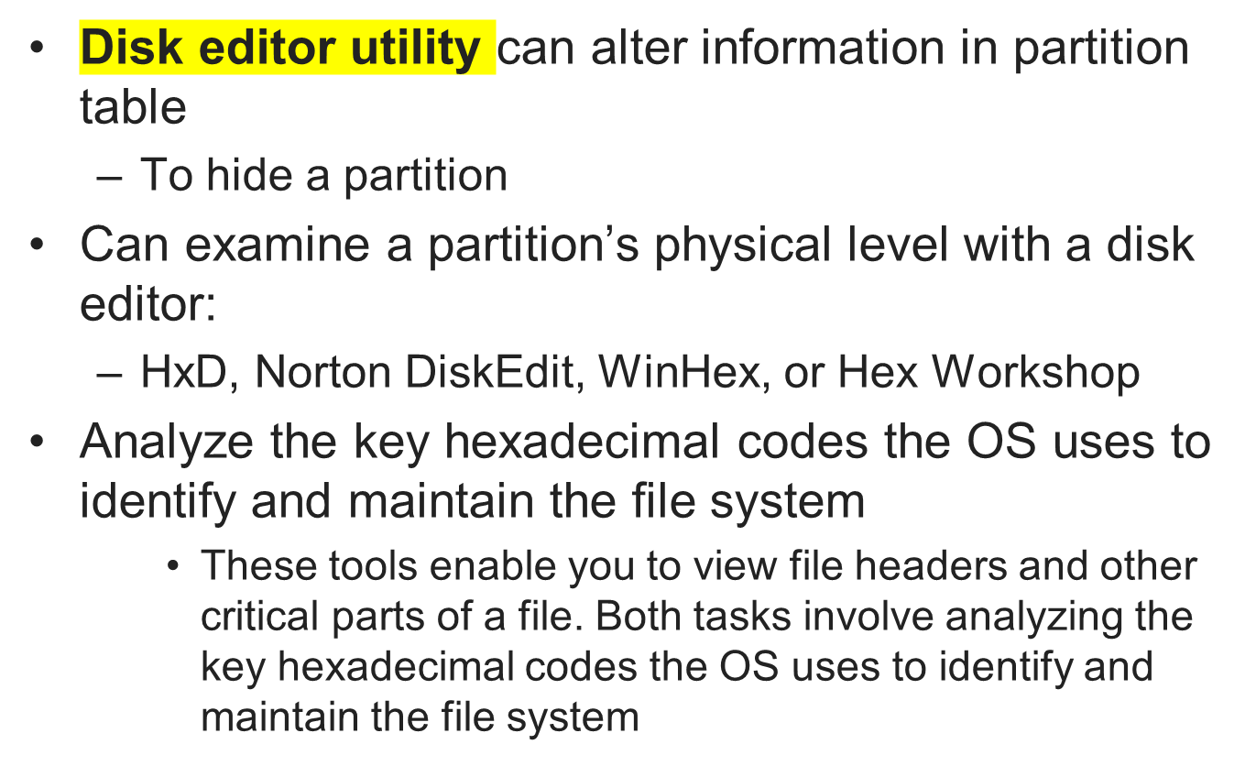
Disk Partitions (continued)

Slide 20
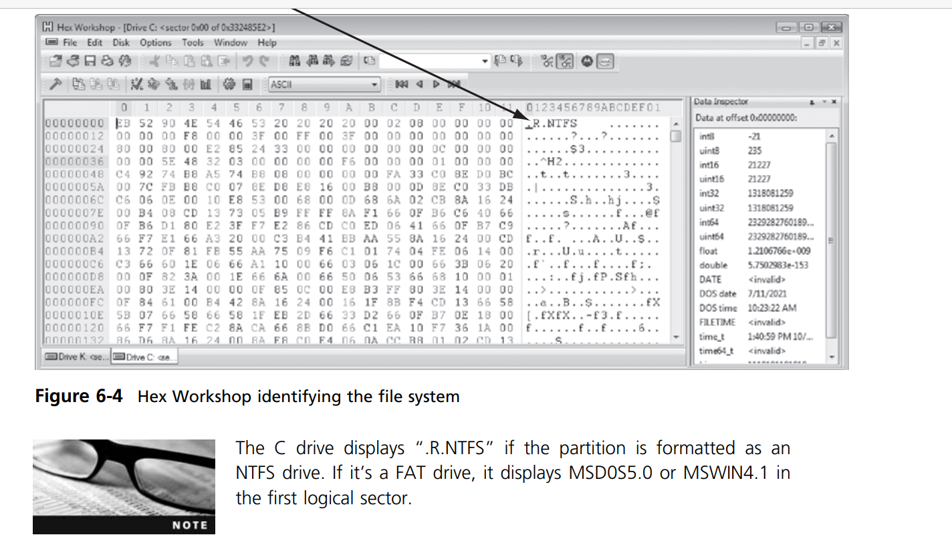
In Hex Workshop, click Disk, Open Drive from the menu to see a list of your logical drives. Click the C: drive (or your working drive), and click OK. Figure shows a typical hard disk in the Hex Workshop window

Slide 21
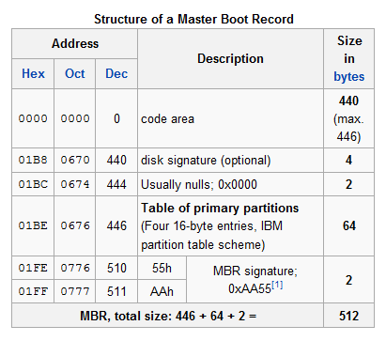
Master Boot Record Structure

Slide 22
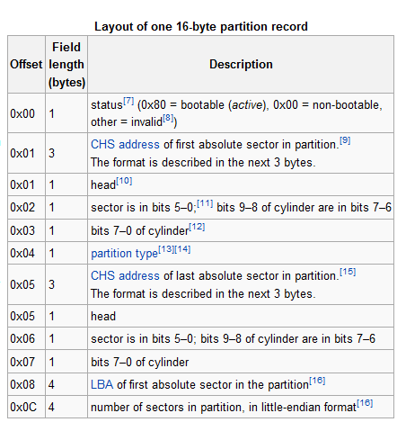
Partition Table Structure

Slide 23
Master Boot Record
On Windows and DOS computer systems
  Boot disk contains a file called the Master Boot Record (MBR)
MBR stores information about partitions on a disk and their locations, size, and other important items
Several software products can modify the MBR, such as PartitionMagic’s Boot Magic

Slide 24
Examining FAT Disks
File Allocation Table (FAT)
  File structure database that Microsoft originally designed for floppy disks
  Used before Windows NT and 2000
FAT database is typically written to a disk’s outermost track and contains:
  Filenames, directory names, date and time stamps, the starting cluster number, and file attributes
FAT versions
  FAT12, FAT16, FAT32, FATX (for Xbox), and VFAT

Slide 25
FAT Versions
FAT12—for floppy disks, max size 16 MB
FAT16—allows hard disk sizes up to 2 GB
FAT32— allows hard disk sizes up to 2 TB 
FATX—For Xbox media
VFAT (Virtual File Allocation Table)
  Allows long file names on Windows (MS-DOS had 8.3 limitation)
Notes:
FAT12—It was originally designed for MS-DOS 1.0, the first Microsoft OS,
• FAT16—MS-DOS 3.0 through 6.22, Windows 95 (first release), and Windows NT 3.5 and 4.0 maximum storage capacity of 2 GB.
• FAT32—Microsoft OSs such as Windows 95 (second release), 98, Me, 2000, XP, and Vista. FAT32 can access up to 2 TB of disk storage. One disk can have multiple partitions in FAT16, FAT32, or NTFS.
• FATX—Xbox media is stored in the FATX format and can be read by any Windows system

Slide 26
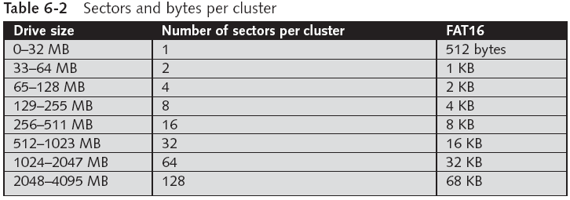
Examining FAT Disks (continued)
Cluster sizes vary according to the hard disk size and file system
This table is for FAT-16

Slide 27
Examining FAT Disks (continued)
Microsoft OSs allocate disk space for files by clusters
  Results in drive slack
    Unused space in a cluster between the end of an active file and the end of the cluster
Drive slack includes:
  RAM slack and file slack
An unintentional side effect of FAT16 having large clusters was that it reduced fragmentation
  As cluster size increased
Notes:
File slack is the unused space between the End Of File and the end of the current cluster.
RAM slack is the unused space between the End Of File and the end of the current sector.

Slide 28
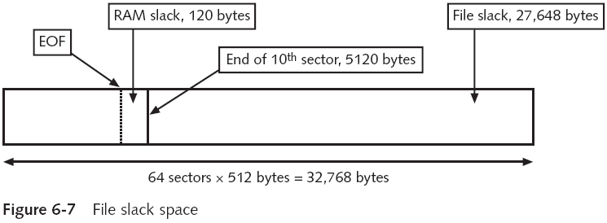
Examining FAT Disks (continued)

Slide 29
Examining FAT Disks (continued)
When you run out of room for an allocated cluster
  OS allocates another cluster for your file, which creates more slack space on the disk
As files grow and require more disk space, assigned clusters are chained together
  The chain can be broken or fragmented

Slide 30
Examining FAT Disks (continued)
When the OS stores data in a FAT file system, it assigns a starting cluster position to a file
  Data for the file is written to the first sector of the first assigned cluster
When this first assigned cluster is filled and runs out of room
  FAT assigns the next available cluster to the file
If the next available cluster isn’t contiguous to the current cluster
  File becomes fragmented

Slide 31
Deleting FAT Files
In Microsoft OSs, when a file is deleted
  Directory entry is marked as a deleted file
    With the HEX E5 (σ) character replacing the first letter of the filename
    FAT chain for that file is set to 0
Data in the file remains on the disk drive
Area of the disk where the deleted file resides becomes unallocated disk space
  Available to receive new data from newly created files or other files needing more space

Slide 32
Examining NTFS Disks
New Technology File System (NTFS)
  Introduced with Windows NT
  Recommended file system for Windows 2000 Pro, XP, and later versions through Windows 7 at least
Improvements over FAT file systems
  NTFS provides more information about a file
  NTFS gives more control over files and folders
NTFS was Microsoft’s move toward a journaling file system

Slide 33
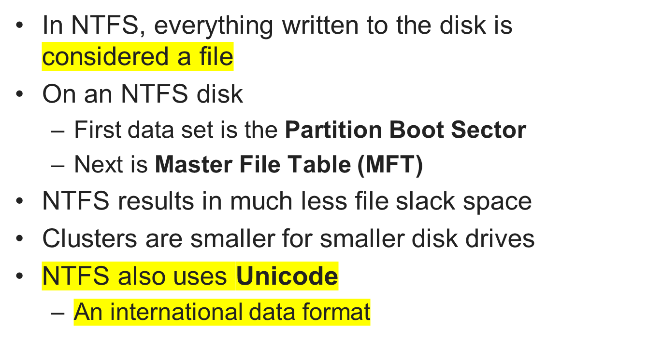
Examining NTFS Disks (continued)

Slide 34
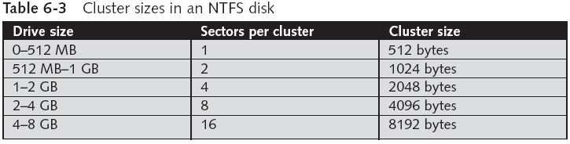
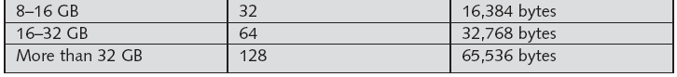
Examining NTFS Disks (continued)

Slide 35
NTFS File System
NTFS offers significant improvements over FAT file systems. It provides more information about a file, including security features, file ownership, and other file attributes.
With NTFS, you also have more control over files and folders (directories) than with FAT file systems.
NTFS was Microsoft’s move toward a journaling file system.
The system keeps track of transactions such as file deleting or saving. This journaling feature is helpful because it records a transaction before the system carries it out.
In NTFS, everything written to the disk is considered a file. On an NTFS disk, the first data set is the Partition Boot Sector, which starts at sector [0] of the disk and can expand to 16 sectors.
Immediately after the Partition Boot Sector is the Master File Table (MFT). The NTFS also uses Unicode, an international data format.

Slide 36
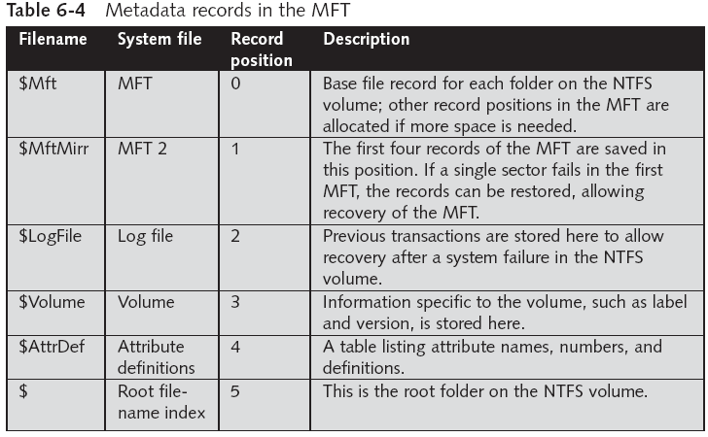
NTFS File System (continued)

Slide 37
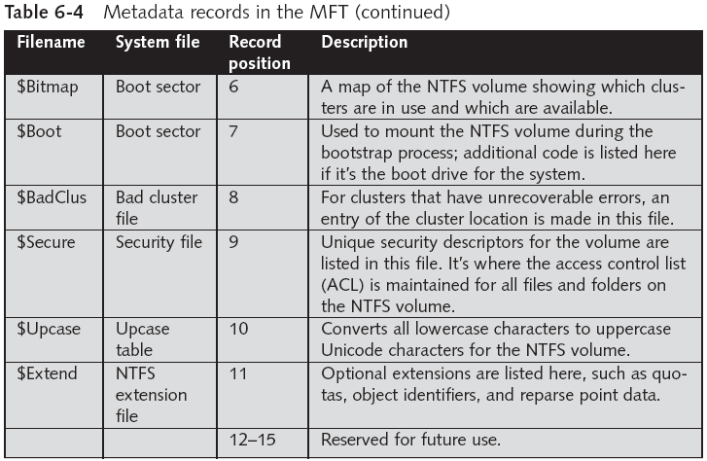
NTFS File System (continued)

Slide 38
MFT and File Attributes
Each record contains file or folder information.
This information is divided into record fields containing metadata about the file or folder and the file’s data or links to the file’s data.
A record field is referred to as an attribute ID. File or folder information is typically stored in one of two ways in an MFT record: resident and nonresident.
For very small files, about 512 bytes or less, all file metadata and data are stored in the MFT record. These types of records are called resident files because all their information is stored in the MFT record.
Files larger than 512 bytes are stored outside the MFT.

Slide 39
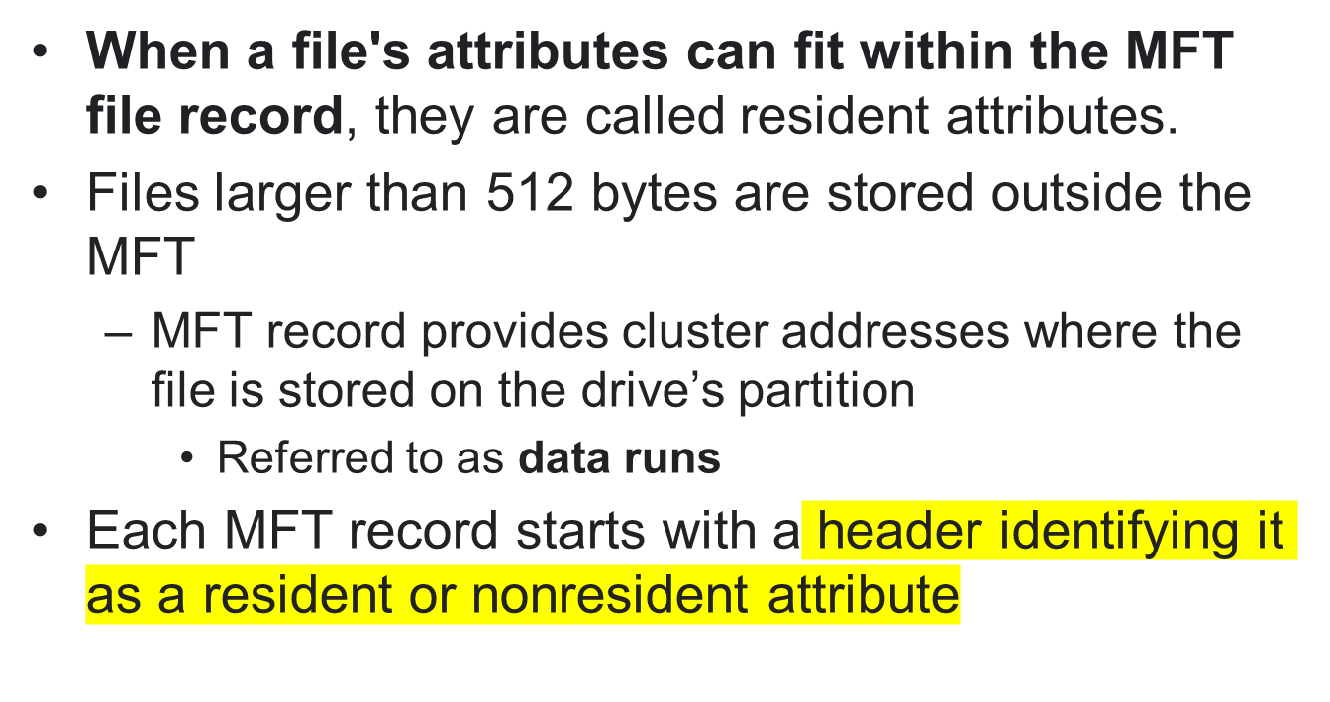
MFT and File Attributes (continued)

Slide 40
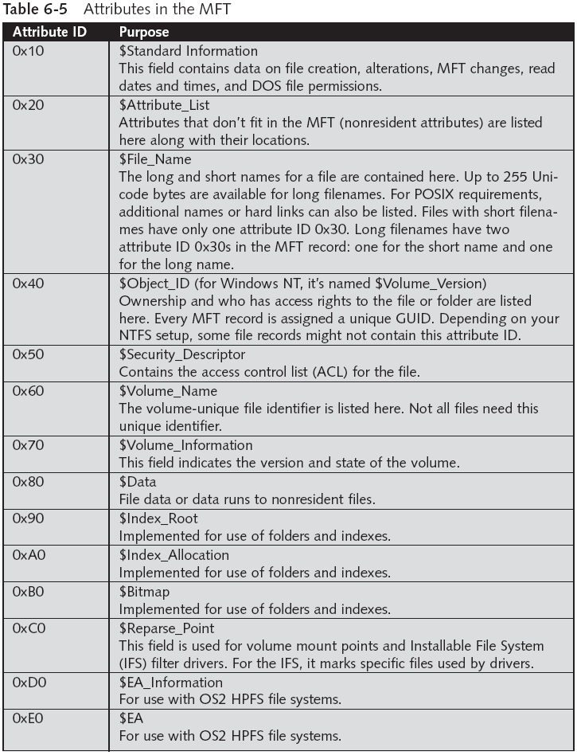

Slide 41
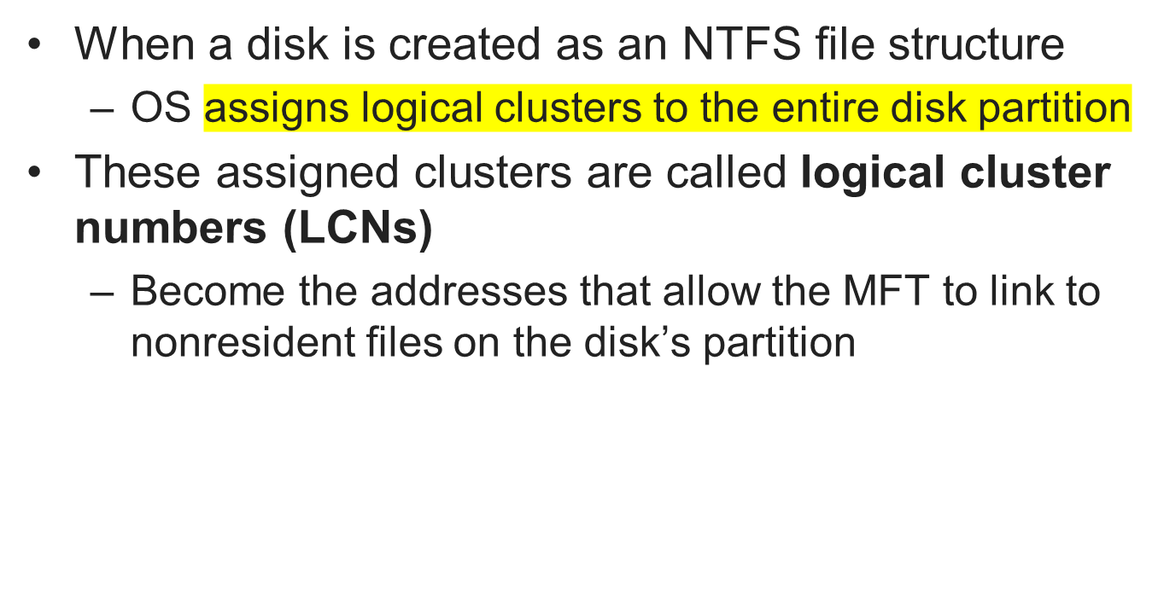
MFT and File Attributes (continued)

Slide 42
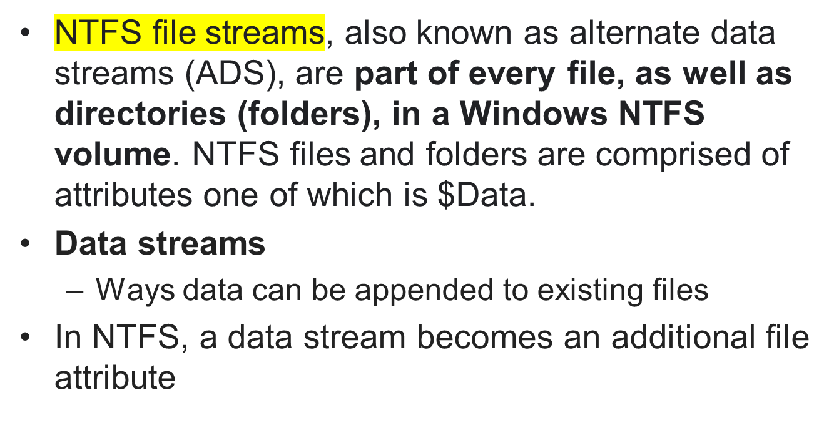
NTFS Data Streams

Slide 43
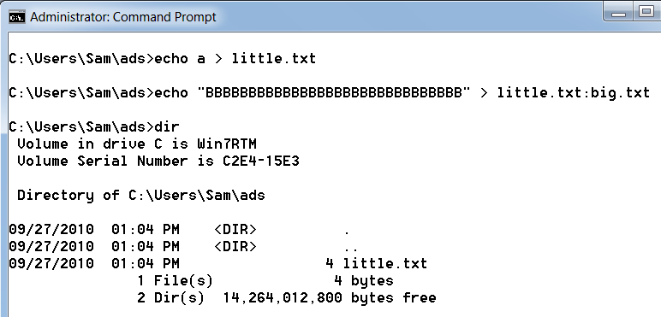
Alternate Data Streams Demonstration

Slide 44
NTFS Compressed Files
NTFS provides compression
Under NTFS, files, folders, or entire volumes can be compressed
Most computer forensics tools can uncompress and analyze compressed Windows data

Slide 45
NTFS Encrypting File System (EFS)
Encrypting File System (EFS)
  Introduced with Windows 2000
  Implements a public key and private key method of encrypting files, folders, or disk volumes
When EFS is used in Windows 2000
  A recovery certificate is generated and sent to the local Windows administrator account
Users can apply EFS to files stored on their local workstations or a remote server

Slide 46
Deleting NTFS Files
When a file is deleted in Windows XP, 2000, or NT
  The OS renames it and moves it to the Recycle Bin
Can use the Del (delete) MS-DOS command
  Eliminates the file from the MFT listing in the same way FAT does

Slide 47
Understanding Whole Disk Encryption

Slide 48
Understanding Whole Disk Encryption
In recent years, there has been more concern about loss of
  Personal identity information (PII) and trade secrets caused by computer theft
Of particular concern is the theft of laptop computers and other handheld devices
To help prevent loss of information, software vendors now provide whole disk encryption

Slide 49
Understanding Whole Disk Encryption (continued)
Current whole disk encryption tools offer the following features:
  Preboot authentication
  Full or partial disk encryption with secure hibernation
  Advanced encryption algorithms
  Key management function
  A Trusted Platform Module (TPM) microchip to generate encryption keys and authenticate logins
Notes:
• Preboot authentication, such as a single sign-on password, fingerprint scan, or token (USB device)
• Full or partial disk encryption with secure hibernation, such as activating a password-protected screen saver
Advanced encryption algorithms, such as AES and IDEA
• Key management function that uses a challenge-and-response method to reset passwords or passphrases • A Trusted Platform Module (TPM) microchip to generate encryption keys and authenticate logins

Slide 50
Understanding Whole Disk Encryption (continued)
Whole disk encryption tools encrypt each sector of a drive separately
Many of these tools encrypt the drive’s boot sector
  To prevent any efforts to bypass the secured drive’s partition
To examine an encrypted drive, decrypt it first
  Run a vendor-specific program to decrypt the drive

Slide 51
Examining Microsoft BitLocker
Available only with Vista/Win 7 Enterprise and Ultimate editions
Hardware and software requirements
  A computer capable of running Windows Vista/7
  The TPM microchip, version 1.2 or newer
  A computer BIOS compliant with Trusted Computing Group (TCG)
  Two NTFS partitions; a 1.5 GB or 100 MB partition use just for BitLocker, and the partition containing Windows
  The BIOS configured so that the hard drive boots first before checking other bootable peripherals

Slide 52
Examining Third-Party Disk Encryption Tools
Some available third-party WDE utilities:
  PGP Whole Disk Encryption
  Voltage SecureDisk
  Utimaco SafeGuard Easy
  Jetico BestCrypt Volume Encryption
  SoftWinter Sentry 2020 for Windows XP
Some available open-source encryption tools:
  TrueCrypt
  CrossCrypt
  FreeOTFE

Slide 53
Understanding the Windows Registry

Slide 54
Understanding the Windows Registry
Registry
  A database that stores hardware and software configuration information, network connections, user preferences, and setup information
For investigative purposes, the Registry can contain valuable evidence
To view the Registry, you can use:
  Regedit (Registry Editor) program for Windows 9x systems
  Regedt32 for Windows 2000 and XP

Slide 55
Hkeys , Hives
The "Handles to the Keys" (HKEYs) are the portals to all the configuration settings in a Windows computer.
A hive is a logical group of keys, subkeys, and values in the registry that has a set of supporting files loaded into memory when the operating system is started or a user logs in.

Slide 56
What are the five registry keys?
In most versions of Windows, the following keys are in the registry:
HKEY_CLASSES_ROOT (HKCR), HKEY_CURRENT_USER (HKCU), HKEY_LOCAL_MACHINE (HKLM), HKEY_USERS (HKU), and HKEY_CURRENT_CONFIG.

Slide 57
Exploring the Organization of the Windows Registry
• Registry—A collection of files containing system and user information.
• Registry Editor—A Windows utility for viewing and modifying data in the Registry. There are two Registry Editors: Regedit and Regedt32 (introduced in Windows 2000).
• HKEY—Windows splits the Registry into categories with the prefix HKEY_. Windows 9x systems have six HKEY categories and Windows 2000 and later have five. Windows programmers refer to the “H” as the handle for the key.
• Key—Each HKEY contains folders referred to as keys. Keys can contain other key folders or values.
•Subkey—A key displayed under another key is a subkey, similar to a subfolder in Windows Explorer.
• Branch—A key and its contents, including subkeys, make up a branch in the Registry.
• Value—A name and value in a key; it’s similar to a file and its data content.
• Default value—All keys have a default value that may or may not contain data.
• Hives—Hives are specific branches in HKEY_USER and HKEY_LOCAL_MACHINE

Slide 58
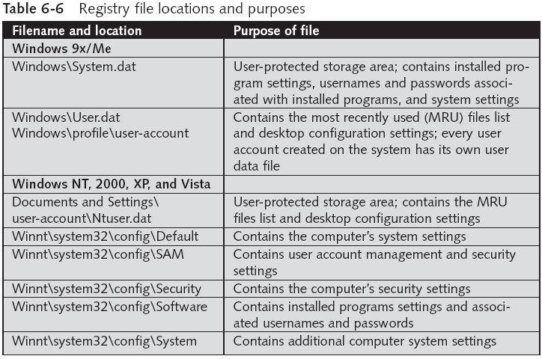
Exploring the Organization of the Windows Registry (continued)

Slide 59
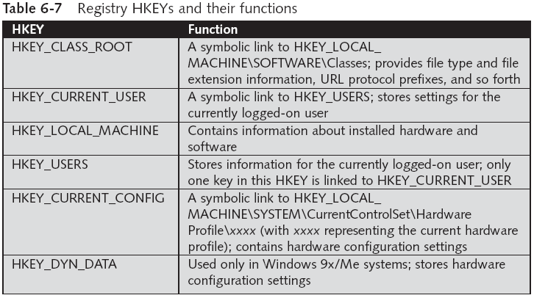
Exploring the Organization of the Windows Registry (continued)

Slide 60
Understanding Microsoft Startup Tasks

Slide 61
A startup disk
A startup disk, also known as a boot disk or system disk, is a disk or drive that contains the necessary files and software to start up a computer operating system.
When a computer is turned on, it reads the startup disk and loads the operating system into the computer's memory. This allows the computer to begin running programs and executing commands.

Slide 62
Startup in Windows NT and Later
All Windows NT computers perform the following steps when the computer is turned on:
  Power-on self test (POST)
  Initial startup
  Boot loader
  Hardware detection and configuration
  Kernel loading
  User logon

Slide 63
Startup Process for Windows Vista
Uses the new Extensible Firmware Interface ( EFI) as well as the older BIOS system.
NT Loader (NTLDR) has been replaced by three boot utilities
  Bootmgr.exe—displays list of operating systems
  Winload.exe—loads kernel, HAL, and drivers
  Winresume.exe—restarts Vista after hibernation

Slide 64
Startup Files for Windows XP
The NT Loader (Ntldr) file loads the OS.
When the system is powered on, Ntldr reads the Boot.ini file, which displays a boot menu.
After you select the mode to boot to, Boot.ini runs Ntoskrnl.exe and reads Bootvid.dll, Hal.dll, and startup device drivers.
Boot.ini specifies the Windows XP path installation and contains options for selecting the Windows version.

Slide 65
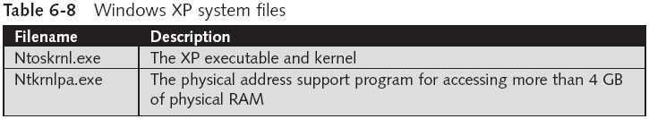
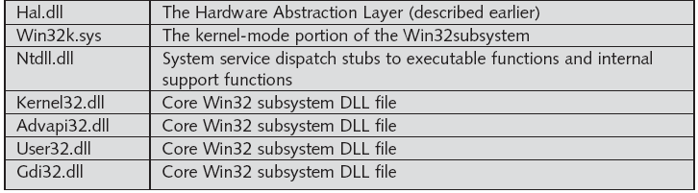
Startup in Windows NT and Later (continued)
Windows XP System Files

Slide 66
Startup in Windows NT and Later (continued)
Contamination Concerns with Windows XP
  When you start a Windows XP NTFS workstation, several files are accessed immediately
    The last access date and time stamp for the files change to the current date and time
  Destroys any potential evidence
    That shows when a Windows XP workstation was last used

Slide 67
Startup in Windows 9x/Me
System files in Windows 9x/Me containing valuable information can be altered easily during startup
Windows 9x and Windows Me have similar boot processes
  With Windows Me you can’t boot to a true MS-DOS mode
Windows 9x OSs have two modes:
  DOS protected-mode interface (DPMI)
  Protected-mode GUI

Slide 68
Startup in Windows 9x/Me (continued)
The system files used by Windows 9x have their origin in MS-DOS 6.22
  Io.sys communicates between a computer’s BIOS, the hardware, and the OS kernel
    If F8 is pressed during startup, Io.sys loads the Windows Startup menu
  Msdos.sys is a hidden text file containing startup options for Windows 9x
  Command.com provides a command prompt when booting to MS-DOS mode (DPMI)

Slide 69
Understanding MS-DOS Startup Tasks

Slide 70
Understanding MS-DOS Startup Tasks
Two files are used to configure MS-DOS at startup:
  Config.sys
    A text file containing commands that typically run only at system startup to enhance the computer’s DOS configuration
  Autoexec.bat
    A batch file containing customized settings for MS-DOS that runs automatically
Io.sys is the first file loaded after the ROM bootstrap loader finds the disk drive

Slide 71
Understanding MS-DOS Startup Tasks (continued)
Msdos.sys is the second program to load into RAM immediately after Io.sys
  It looks for the Config.sys file to configure device drivers and other settings
Msdos.sys then loads Command.com
As the loading of Command.com nears completion, Msdos.sys looks for and loads Autoexec.bat

Slide 72
Other Disk Operating Systems
Control Program for Microprocessors (CP/M)
  First nonspecific microcomputer OS
  Created by Digital Research in 1970
  8-inch floppy drives; no support for hard drives
Digital Research Disk Operating System (DR-DOS)
  Developed in 1988 to compete with MS-DOS
  Used FAT12 and FAT16 and had a richer command environment

Slide 73
Other Disk Operating Systems (continued)
Personal Computer Disk Operating System (PC-DOS)
  Created by Microsoft under contract for IBM
  PC-DOS works much like MS-DOS

Slide 74
Understanding Mac OS 9 Volumes
A volume is any storage medium used to store files. A volume can be all or part of the storage media for hard disks
Volumes have allocation blocks and logical blocks. A logical block is a collection of data that can’t exceed 512 bytes.
When you save a file, File Manager assigns the file to an allocation block, which is a group of consecutive logical blocks.
As volumes increase in size, one allocation block might be composed of three or more logical blocks.

Slide 75
A logical block is the smallest unit of storage that can be addressed by the file system. It is typically a fixed size, often 512 bytes,
Logical blocks are numbered sequentially and are used to locate and access data within a file or on a storage device.
An allocation block, on the other hand, is a group of one or more contiguous logical blocks that are allocated to a file or directory. It represents the minimum amount of space that can be allocated for a file or directory. Allocation blocks are also referred to as clusters

Slide 76
The Macintosh HFS
Hierarchical File System (HFS)
The Macintosh HFS and HFS+ file systems have two descriptors for the end of file (EOF)— the logical EOF and the physical EOF.
The logical EOF is the actual size of the file, so because file B is 510 bytes, byte 510 is the logical EOF.
The physical EOF is the number of allocation blocks for that file.

Slide 77
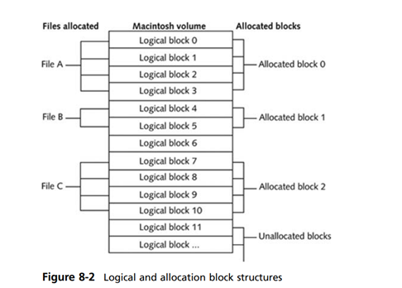

Slide 78
Exploring Macintosh Boot Tasks
1. Power on the computer.
2. Hardware self-test and Open Firmware run.
3. Macintosh OS starts.
4. The startup disk is located.
5. System files are opened.
6. System extensions are loaded.
7. OS 9 Finder starts.

Slide 79
UNIX Disc Structure
Boot block, superblock, inode block, and data block. A block is the smallest disk allocation unit in the UNIX file system and can be 512 bytes and up.
A UNIX/Linux computer has only one boot block, located on the main hard disk.
The superblock contains vital information about the system and is considered part of the metadata.
It indicates the disk geometry, available space, and location of the first inode and keeps track of all inodes.

Slide 80
The superblock also block size for the drive, file system names, blocks reserved for inodes, free inode list, free block starting chain, volume name, and inodes for last update time and backup time.
Multiple copies of the superblock are kept in various locations on the disk to prevent losing such important information
Inode blocks are the first data after the superblock. An inode is assigned to every file allocation unit.
As files or directories are created or deleted, inodes are also created or deleted.

Slide 81
Understanding UNIX and Linux Boot Processes
When you power on a UNIX workstation, instruction code stored in firmware on the system’s CPU loads into RAM. This firmware is called memory-resident code because it’s located in ROM.
As soon as the memory-resident code is loaded into RAM, the instruction code checks the hardware. Typically, the code first tests all components, such as RAM chips, to verify that they’re available and capable of running.
Then it probes the bus, looking for a device containing the boot program, such as a hard disk, floppy disk, or CD. When it locates the boot device, it starts reading the boot program into memory.
The boot program, in turn, reads the kernel into memory. When the kernel is loaded, the boot program transfers control of the boot process to the kernel.
The kernel’s first task is to identify all devices. It then configures the identified devices and starts the system and associated processes.
After the kernel becomes operational, the system is usually booted to single-user mode, in which only one user can log on.

